Slide 1

Operating Systems

Slide 2

Why to Study Operating Systems?
In the perspective of Software Development
  Knowledge of OS is important for programming – whether it is system or application.
    For application programming, knowledge of OS is useful but not pre-requisite.
    For System programming it is other-way round. Without OS knowledge you cannot do any system programming.

Slide 3
Why to Study Operating Systems?
In perspective of Campus Interview
  Certainly few questions will be there in the interview or even in the written tests.
In perspective of GATE
  Generally every year questions from memory management and inter process communication are asked.
  However this cannot be treated as a standard topic of coverage.

Slide 4
System Software
System software enables the hardware to operate as a computer system. It serves as the interface between the hardware and the user.
System software consists of
  Operating system and
    Controls and manage the hardware and allows the user to run other applications
  Utility programs
    Perform a specific task usually related to managing system resources.

Slide 5
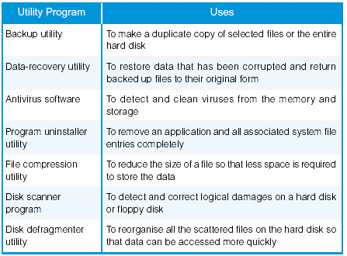
Utility Program

Slide 6
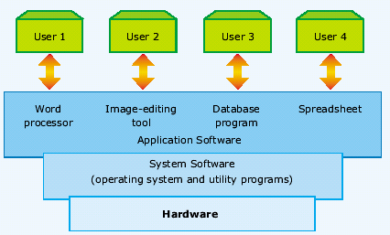
Abstract View of system components

Slide 7
Overview and History
Operating System driven by Cost of resources
Much of operating system history driven by relative cost factors of hardware and people. In the beginning:
  Expensive Hardware, Cheap People ( Phase I )
    Goal: maximize hardware utilization.
  Now: Cheap Hardware, Expensive People ( Phase II )
    Goal: make it easy for people to use computer.
Relative costs drive the goals of the operating system.

Slide 8
Phase – I, Hardware is costly
Problem: Sequences to execute a program
Solution:
The program would be loaded manually into memory, from the front panel switches(one instruction at a time) from a paper tape or punched cards.
Then appropriate buttons would be pushed to set the starting address and to start the execution of the program.
As the program ran, programmer could monitor its execution.
If errors were discovered, the programmer could halt the program, examine the contents of memory and registers and debug the program directly from the console.
O/P was printed or was punched onto cards or paper tape for later printing.

Slide 9
Phase – I, Hardware is costly
Programmers interact with the machine at a very low level, dump cards into card reader, etc. The interface is basically the raw hardware.
  Problem: Code to manipulate external I/O devices is very complex, and is a major source of programming difficulty.
  Solution: Build a subroutine library (device drivers) to manage the interaction with the I/O devices. The library is loaded into the top of memory and stays there. This is the first example of something that would grow into an operating system.

Slide 10
Maximizing machine utilization
Because the machine is so expensive, it is important to keep it busy.
  Problem: computer idles while programmer sets things up. Poor utilization of huge investment.
  Solution: Hire a specialized person to do setup. Faster than programmer, but still a lot slower than the machine.
  Solution: Store jobs on a disk (spooling), have computer read them in one at a time and execute them. Build a batch monitor. Big change in computer usage: debugging now done offline from print outs and memory dumps. No more instant feedback.

Slide 11
Mainframe Systems
Reduce setup time by batching similar jobs
Automatic job sequencing – automatically transfers control from one job to another. First rudimentary operating system.
Resident monitor
  initial control in monitor
  control transfers to job
  when job completes control transfers back to monitor

Slide 12
CPU and I/O utilization
Problem: At any given time, job is actively using either the CPU or an I/O device, and the rest of the machine is idle and therefore unutilized.
Solution: Allow the job to overlap computation and I/O. Buffering and interrupt handling added to subroutine library.

Slide 13
Utilization of CPU & I/O
Problem: one job can't keep both CPU and I/O devices busy. Get poor utilization either of CPU or I/O devices.
Solution: multiprogramming - several jobs share system. Dynamically switch from one job to another when the running job does I/O.
Big issue: protection. Don't want one job to affect the results of another. Memory protection and relocation added to hardware, OS must manage new hardware functionality. OS starts to become a significant software system.

Slide 14

Multiprogrammed Batch Systems
Several jobs are kept in main memory at the same time, and the
CPU is multiplexed among them.

Slide 15
OS Features Needed for Multiprogramming
I/O routine supplied by the system.
Memory management – the system must allocate the memory to several jobs.
CPU scheduling – the system must choose among several jobs ready to run.
Allocation of devices.

Slide 16
Performance Tuning - Multiprogramming
If there are N jobs and each one takes T₁, T₂ … T_{N} respectively, to run in a single programming environment, the total time taken for the execution of all the jobs will be T₁ + T₂ …+ T_{N.}
Whereas in a multiprogramming environment, the total time taken for the execution of all the jobs will be less than above.

Slide 17
Do you know this?
The first generation of windows, including windows 1.0, 2.0, 3.0, 3.1 and 3.11, that were not really operating systems
Instead they were GUI environments that worked as a DOS foundation.
The first GUI operating systems developed by Microsoft is Windows ‘95

Slide 18
Phase II -- Man is costly
Issue: It becomes important to make computers easier to use and to improve the productivity of the people.
  One big productivity sink: having to wait for batch output . So, it is important to run interactively. But computers are still so expensive that you can't buy one for every person.
Solution: interactive timesharing.
Problem: Old batch schedulers were designed to run a job for as long as it was utilizing the CPU effectively (in practice, until it tried to do some I/O). But now, people need reasonable response time from the computer.
Solution: Preemptive scheduling.

Slide 19
Necessity of Files
Problem: People need to have their data and programs around while they use the computer.
Solution: Add file systems for quick access to data. Computer becomes a repository for data, and people don't have to use card decks or tapes to store their data.

Slide 20
Prioritized Scheduling & Resource management
Problem: The boss logs in and gets terrible response time because the machine is overloaded.
Solution: Prioritized scheduling. The boss gets more of the machine than the peons.
But, CPU scheduling is just an example of resource allocation problems.
The timeshared machine was full of limited resources (CPU time, disk space, physical memory space, etc.) and it became the responsibility of the OS to mediate the allocation of the resources.
So, developed things like disk and physical memory quotas, etc.

Slide 21
What is an Operating System?
A program that acts as an intermediary between a user of a computer and the computer hardware.
Operating system goals:
  Execute user programs and make solving user problems easier.
  Make the computer system convenient to use.
Use the computer hardware in an efficient manner.

Slide 22
How to view an OS?
Resource allocator – manages and allocates resources.
Control program – controls the execution of user programs and operations of I/O devices .
Kernel is OS
  Kernel – the one program running at all times (all else being application programs).

Slide 23
Desktop Systems
Personal computers – computer system dedicated to a single user.
I/O devices – keyboards, mouse, display screens, small printers.
User convenience and responsiveness.
Can adopt technology developed for larger operating system’ often individuals have sole use of computer and do not need advanced CPU utilization of protection features.
May run several different types of operating systems (Windows, MacOS, UNIX, Linux)

Slide 24
Test Yourself
Select the single user operating systems
  MS-DOS
  Unix
  Windows 2000 server
  Mach

Slide 25
Question of the day
What does the CPU do when there is no program to process?
  The CPU runs an idle loop repeatedly.

Slide 26
Parallel Systems
Multiprocessor systems with more than one CPU in close communication.
Tightly coupled system – processors share memory and a clock; communication usually takes place through the shared memory.
Advantages of parallel system:
  Increased throughput
  Economical
  Increased reliability
    graceful degradation
    fail-soft systems / fault tolerant systems

Slide 27
Types of Multiprocessing OS
The basic types of multiprocessor OS are:
  Master / Slave
  Symmetric

Slide 28
Multiprocessing OS
Master - Slave
  In only one processor the OS will be running
  Master Schedules the work and controls the activity of the slaves.
  Slave processors can process directly some simple queries
  Majority of OS services are provided by the master.

Slide 29
Multiprocessing OS
Symmetric Operating System
  All processors are functionally identical.
  They are pool of anonymous resources
  Other hardware resources, such as memory and I /O devices, may also be pooled so as to be available to all processors.
  If only one or just a few processors have access to I/O devices, the system is asymmetric.
  OS is also symmetric in the sense that any processor may execute it.
  Floating master is a simple form of symmetric organization

Slide 30
Multiprocessing OS
Symmetric Operating System contd.
  Floating master
    In response to the workload requirements and processor availability, the OS is executed by different processors at different times.
    Temporarily the processor that has the OS acts like a master processor.
    The OS can float from one processor to another and so floating master.

Slide 31

Symmetric Multiprocessing Architecture

Slide 32
Multiprogramming & Multiprocessing
Multiprogramming refers to running more than 1 program on a single computer.
Multiprocessing refers to using more than 1 computer (processor) at the same time.

Slide 33
Can there be a combination of the two ?
Yes
For example a multiprogramming multiprocessing system
  will run many programs on multiple processors.
  The users won't know which processor their program is running

Slide 34
What could be Uniprogramming multiprocessing system ?
1 program is run on all the processors.
This is done by dividing up the program into independent portions and simultaneously running them on the different processes
An example of this is processing payroll where each processor may be calculating payroll for a 1000 employees
  the payroll of 1 employee does not depend on the payroll of another

Slide 35
Distributed Systems
Distribute the computation among several physical processors.
Each processor has its own local memory; processors communicate with one another through various communications lines, such as high-speed buses or telephone lines.
Advantages of distributed systems.
  Resources Sharing
  Computation speed up – load sharing
  Reliability
  Communications

Slide 36
Distributed Systems (cont)
Requires networking infrastructure.
Local area networks (LAN) or Wide area networks (WAN)
May be either client-server or peer-to-peer systems.

Slide 37
Real Time System
A Real time system is a system where:
  There is a continuous interaction with the environment ( reactive system)
  The environment changes in real time and imposes timing constraints on the systems
  The system simultaneously controls and / or reacts to different aspects of the environment (concurrent systems)
Real time system is a well-defined fixed-time constraints.

Slide 38
Examples of RTS
Some examples of real time systems are
  Medical Monitoring Systems.
  Car control systems, ABS systems, engine control system.
  Fighter plane control systems
  Aircraft simulators ( or even computer games)
  Industrial control systems

Slide 39
Real-Time System Classification
Real-Time systems may be either hard or soft real-time.
Hard Real Time Systems:
  Events must happen at a certain time, the system should respond within some fixed time.
Soft Real Time Systems:
  Exact Response time is not critical.

Slide 40
Hard Real Time System
Consider a control system for an aircraft. If the pilot is not giving new information about the environment quickly then the information is useless.
It is no use being told what the air speed was 10 minutes ago.
Also if a pilot gives a command (e.g. lower landing gear) he wants that done now, even a minute later could have some bad effect.
These systems are hard real time systems.

Slide 41
Soft Real Time System
Consider a multimedia presentation system, this could be considered a real time system. But it doesn't really matter if all the deadlines are met on time as long as most of the time the deadlines are met.

Slide 42
Need for OS in RTS
Real time system are concurrent. It is bad software engineering to produce one big monolithic program which implements all the control.
Instead we split our problem into a number of tasks which then must be scheduled so that they can all complete their jobs at the right time.
It is the job of the OS of the system or some supervisor program to execute the tasks at the required time.

Slide 43
Handheld Systems
Personal Digital Assistants (PDAs)
Cellular telephones
Issues:
  Limited memory
  Slow processors
  Small display screens.

Slide 44
What makes an operating system modern?
According to author Andrew Tanenbaum, it is the awareness of high-demand computer applications--primarily in the areas of multimedia, parallel and distributed computing, and security.

Slide 45
Multitasking
Let us take an example of an embedded application in microwave Owen
  What does it takes and what are processed?
    Needs to respond to user requests from a keypad
    Measure some variable, such as temperature
    Control the magnetron for power level and time
    Updating a display in real time.

Slide 46
Pseudocode for the above problem
do forever
{
check keypad;
measure temperature;
control oven power;
decrement timer;
update display;
wait for clock tick;
}
what happens if one of the operations takes a long time?
Or you can't run the loop fast enough to give a good response to the keypad?

Slide 47
Multitasking Contd..
You may be able to improve things a bit by repeating some operations more than once in the loop. eg.
  Check keypad
  measure temperature
  check keypad control
  oven check keypad etc...

Slide 48
Multitasking Contd..
  But the problem becomes more complex as the need arises.
  The better solution for this is multitasking.
  You can then divide your problem into a number of separate tasks and let the operating system take responsibility for managing the CPU so that each function thinks it owns the entire system.

Slide 49
Virtual Machine
In an interactive time sharing environment, multiple interactive sessions are implemented by a set of virtual machine, one for each user.
  Virtual machine is a simulation of real hardware implemented by OS.
  Each user interacts with the computer by typing commands to the VM and receiving the results back from the machine as soon as they are computed.

Slide 50
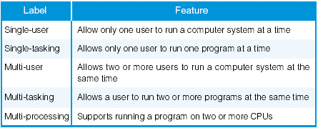
Summary

Slide 51
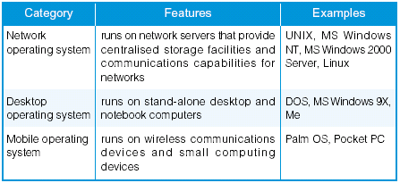
Common Operating Systems

Slide 52
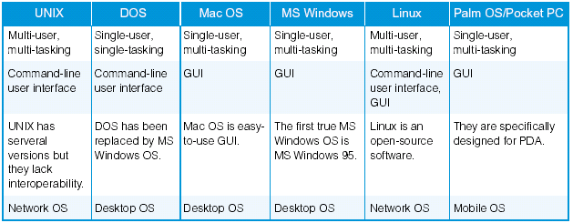
Overview of different Operating Systems

Slide 53
Traps and Interrupts
Interrupts
  An interrupt is a signal sent to the CPU by an external device, typically I/O.
  Traps
    Abnormal Condition detected by the CPU that usually is indicative of an error. For example
      Dividing by zero
      Accessing memory that does not exist or for which the program has not access to.
      Executing an instruction with an undefined opcode or trying to access a non existent I/O device.

Slide 54
How does the interrupts & traps are handled?
The address the CPU jumps to is determined by the hardware architecture.
The architecture defines an address in memory to be the location of an interrupt vector.
  Each trap or interrupt is associated with an index into that vector pointed to by the trap or interrupt’s index.
  The branch address is determined by the contents of the memory location in the vector pointed to by the trap or interrupt’s index.

Slide 55
Which is difficult?
Handling Interrupts or traps.
An hint:
    Interrupts are asynchronous
    Traps are synchronous

